Slide 1

Notes:
Hello everyone and welcome to today’s webinar: "Build a custom Ohai Plugin"

Slide 2

Franklin Webber
Trainer by Day, Gnome by Night
Franklin Webber
Notes:
My name is Franklin Webber. I'm a training lead here at Chef and I’m honored that you chose to be a part of this session today.

Slide 3

ChefConf 2017
Training and More
Notes:
My name is Franklin Webber. I'm a training lead here at Chef and I’m honored that you chose to be a part of this session today.

Slide 4
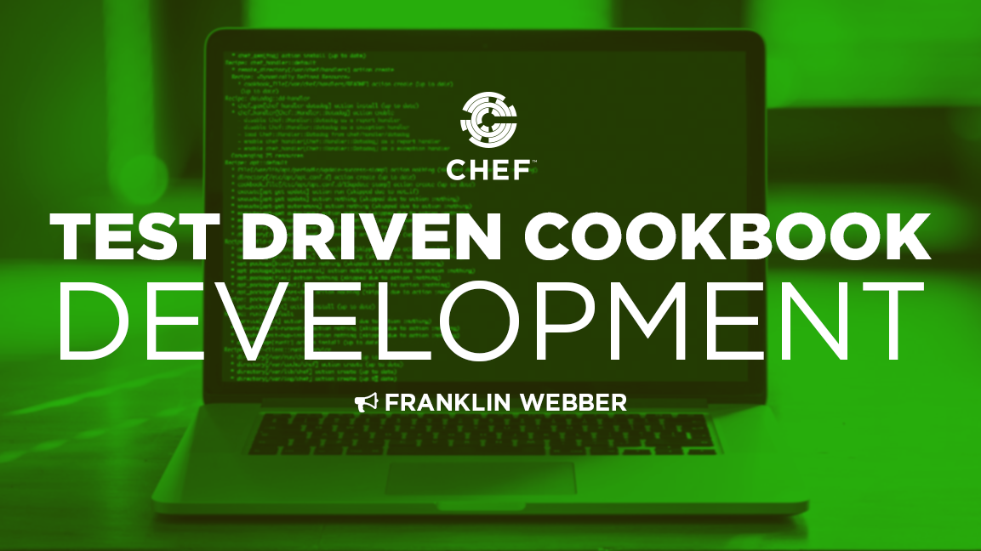


Who I Think You Are
Chef Cookbook Author
Build and maintain Chef Cookbooks
Build and execute ChefSpec Tests
Interest in learning how to create and test an Ohai plugin
OR
Training
training.chef.io
Chef Essentials
Test-Driven Cookbook Development
chef.io/webinars/?commid=191263
chef.io/webinars/?commid=194483
Notes:
When creating this presentation I spent a lot of time thinking about who you are to help guide me in preparing the best content to assist you and to define the scope of what to share with you.
First and foremost I made the assumption that you are an author or co-author of cookbooks. By that I mean you have edited or created recipes and defined attributes. During your time working with Chef you have written unit tests to help describe the intended purpose of your recipes. Ideally I am talking to some of you that have created a bit of a problem for yourself with how big your test suite has become. And whether or not you have that problem you are interested in learning more about how Ruby's RSpec can increase the elegance of the tests you write.

Slide 5
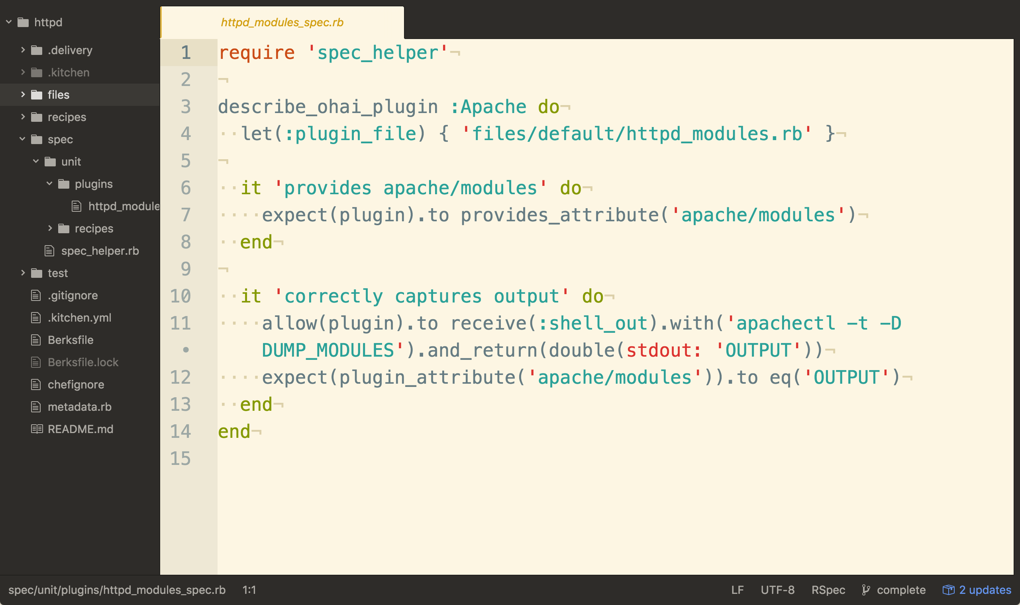
What You Will Learn
The Focus
Define a test to capture our plugin requirements
Build the ohai plugin
Build a recipe to deliver the plugin
Notes:
During this session we will identify and tackle repetition present within an example cookbook that addresses the needs across multiple platforms. This cookbook installs multiple packages, sets multiple attributes, and is supported across multiple platforms and platform families.

Slide 6
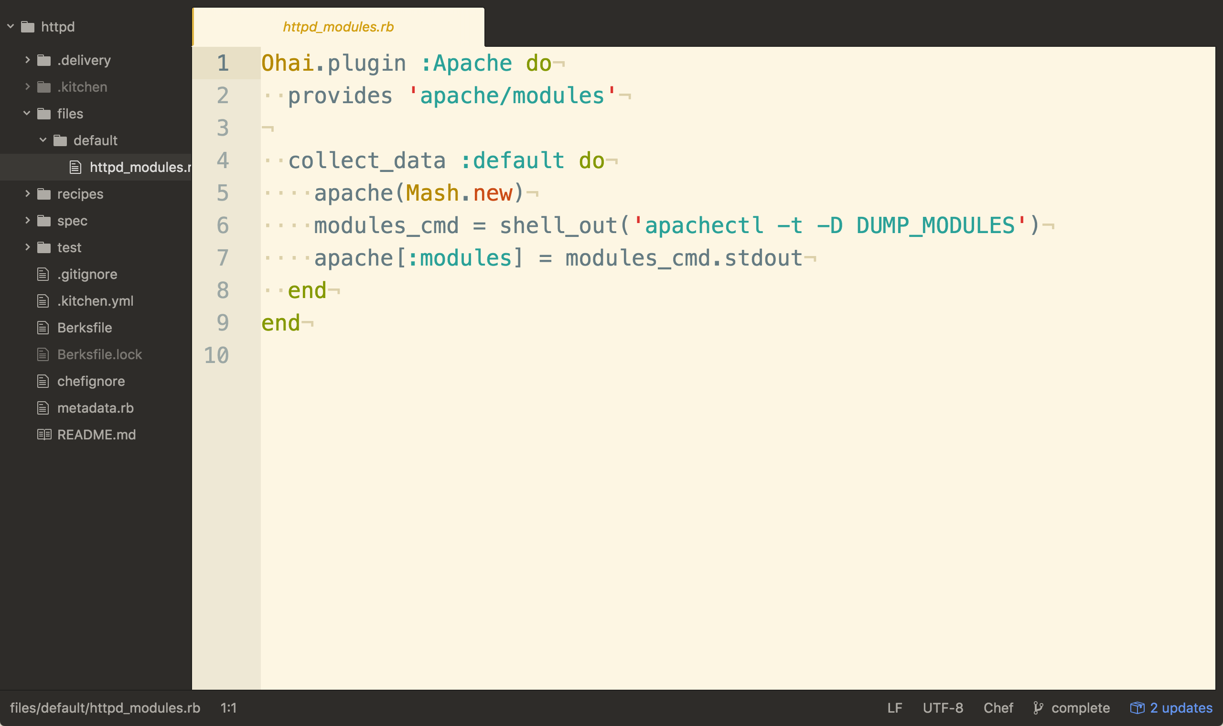
What You Will Learn
The Focus
Define a test to capture our plugin requirements
Build the ohai plugin
Build a recipe to deliver the plugin
Notes:
The result would be a resulting test that looks like the following. Reducing the platform setup, expressing more clearly the packages that are installed, and making it easier to express that the attributes are set.

Slide 7
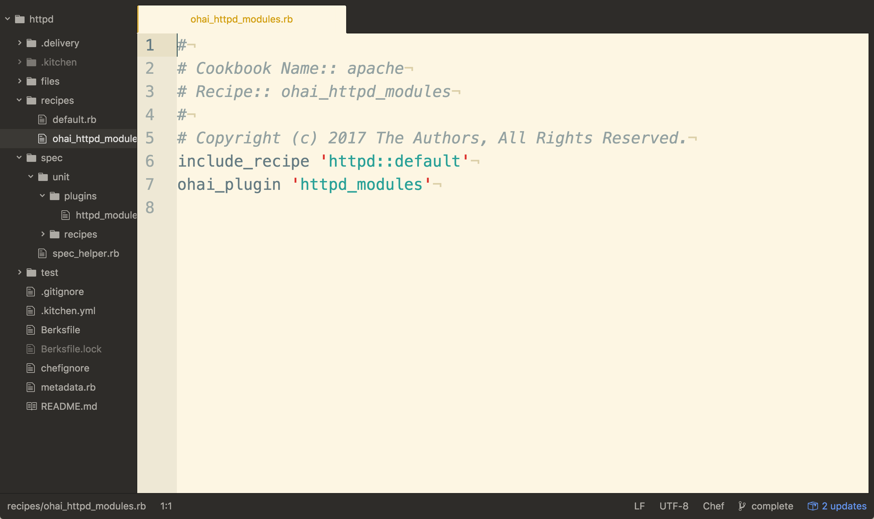
What You Will Learn
The Focus
Define a test to capture our plugin requirements
Build the ohai plugin
Build a recipe to deliver the plugin
Notes:
And at the end we'll take all these helpers that we move to a common file within the cookbook and bring it into a re-usable library that we can share with all the cookbooks that we write.

Slide 8
Schedule
Introduction (5 minutes)
Build and Test Ohai Plugin (40 minutes)
Questions (12 minutes)
Resources (3 minutes)
Hack Time
Join the Chef Community Slack #webinar-ohai
Notes:
This is the schedule of events of today. We'll finish up with these housekeeping items and then we'll move into our series of concepts, then stop for questions, and finally wrap up the work that we have done and where you can go to learn more.

Slide 9
Example Code Repository
> git clone https://github.com/chef-training/webinar-ohai-repo.git
Cloning into 'webinar-ohai-repo'...
remote: Counting objects: 67, done.
remote: Compressing objects: 100% (41/41), done.
remote: Total 67 (delta 12), reused 67 (delta 12), pack-reused 0
Unpacking objects: 100% (67/67), done.
Notes:
If you want to play along with me and work on the same cookbook that I am using as an example you can clone the code from the chef-training GitHub organization.

Slide 10

Let Us Have a Discussion
"Ask a Question" and I will answer it.
"Rate this" presentation to leave your feedback and help me do my work better.
To share, click on the appropriate professional/social network in "Details"
Notes:
We’d love to hear from you during today’s presentation. I’ll be answering questions at the end of the session, so please feel free to send those along using the ‘Ask a Question’ tab on the top of your screen.
If you want to leave a comment and tell me how I did and how we are doing here at Chef please leave a rating and tells us what you liked, what you didn't like, and what you would like to see more of during these sessions.
And last, I'd like to encourage you to share today’s webinar with your professional and social networks.

Slide 11
Writing Elegant Tests
Notes:
For those of you just joining, welcome to today’s session, ‘,’ I'm Franklin Webber. Let’s get started...

Slide 12
Agenda
Oh hai Ohai!
Meet and Greet with Ohai's Plugins
Build the Ohai plugin
Build a Recipe to deliver the plugin
Tuning Ohai
Questions
Resources
Hack Time!
CONCEPTS
TECHNICAL
TIPS
DISCUSSION

Slide 13
Ohai
Ohai is a tool that is used to detect attributes on a node, and then provide these attributes to the chef-client at the start of every chef-client run. The types of attributes Ohai collects include (but are not limited to):
Platform details
Network usage
Memory usage
CPU data
Notes:
Ohai is a tool that is used to detect attributes on a node, and then provide these attributes to the chef-client at the start of every chef-client run. Ohai is required by the chef-client and must be present on a node. (Ohai is installed on a node as part of the chef-client install process.)

Slide 14
Exploring Ohai
To understand Ohai we must explore it in isolation, understand where it fits in the ecosystem, and how the data it provides is stored.
Execute Ohai to retrieve details about the node
View Ohai's execution within a chef-client run
Describe attributes precedence
Notes:
As a group we will explore using Ohai from the command-line then view how it is executed within a chef-client run and then talk about the attributes that it collects. We'll start with ohai the command-line tool.

Slide 15
All About The System
Ohai queries the operating system with a number of commands.
The data is presented in JSON (JavaScript Object Notation).
Notes:
Ohai, the command-line application, will output all the system details represented in JavaScript Object Notation (JSON).

Slide 16
Running Ohai to Show All Attributes
> ohai
{
"kernel": {
"name": "Linux",
"release": "2.6.32-431.1.2.0.1.el6.x86_64",
"version": "#1 SMP Fri Dec 13 13:06:13 UTC 2013",
"machine": "x86_64",
"os": "GNU/Linux",
"modules": {
"veth": {
"size": "5040",
"refcount": "0"
},
"ipt_addrtype": {
Notes:
Ohai is also a command-line application that is part of the ChefDK. When you run it you will see the entire JSON representation of the system.

Slide 17
Running Ohai to Show the IP Address
> ohai ipaddress
[
"172.31.57.153"
]
Notes:
You can also run ohai with a parameter. In this case when we want only the ipaddress from the entire body of information we can provide it as a parameter.

Slide 18
Running Ohai to Show the Hostname
> ohai hostname
[
"ip-172-31-57-153"
]
Notes:
Similar, we can specify the hostname to return only the hostname of the system.

Slide 19
Running Ohai to Show the Memory
> ohai memory
{
"swap": {
"cached": "0kB",
"total": "0kB",
"free": "0kB"
},
"total": "604308kB",
"free": "297940kB",
"buffers": "24824kB",
"cached": "198264kB",
Notes:
When we ask for the memory of the system we receive a hash that contains a number of keys and values.

Slide 20
Running Ohai to Show the Total Memory
> ohai memory/total
[
"604308kB"
]
Notes:
We can grab a single value, like the total memory, by specifying a slash between the top-level key and the next level key underneath it. This command will return the total memory of the system.

Slide 21
Running Ohai to Show the CPU
> ohai cpu
{
"0": {
"vendor_id": "GenuineIntel",
"family": "6",
"model": "45",
"model_name": "Intel(R) Xeon(R) CPU E5-2650 0 @ 2.00GHz",
"stepping": "7",
"mhz": "1795.673",
"cache_size": "20480 KB",
"physical_id": "34
Notes:
We can return all the details about the cpu. We see that there is one cpu, named '0', that contains more information.

Slide 22
Running Ohai to Show the First CPU
> ohai cpu/0
{
"vendor_id": "GenuineIntel",
"family": "6",
"model": "45",
"model_name": "Intel(R) Xeon(R) CPU E5-2650 0 @ 2.00GHz",
"stepping": "7",
"mhz": "1795.673",
"cache_size": "20480 KB",
"physical_id": "34",
"core_id": "0",
"cores": "1",
"flags": [
Notes:
Here we are asking for all the details about the cpu named '0'.

Slide 23
Running Ohai to Show the First CPU Mhz
> ohai cpu/0/mhz
[
"1795.673"
]
Notes:
And finally if we wanted to display the Megahertz of that specific cpu we can append an additional key to the parameter.

Slide 24
Ohai is Composed of Plugins
Ohai is packaged with a core set of plugins that are automatically loaded when executing Ohai.
These plugins provide the attributes we see in the JSON output (e.g. ipaddress, hostname, memory, cpu).
Example Plugins
Ohai
NetworkAddresses
ipaddress, ip6address, macaddress
Hostname
hostname, domain, fqdn, machinename
Memory
memory, memory/swap
CPU
cpu
Notes:
Ohai is composed of plugins that collect these different attributes. When you execute Ohai it will load the core plugins that are packaged with it.

Slide 25
Custom Ohai Plugins
It is possible to define your own plugins and have Ohai load those plugins.
> ohai -d PATH_TO_CUSTOM_PLUGINS
We will explore creating an Ohai plugin and loading it with Ohai from the command-line in the Build an Ohai Plugin' module.
Notes:
Ohai is composed of plugins that collect these different attributes. When you execute Ohai it will load the core plugins that are packaged with it.

Slide 26
Exploring Ohai
To understand Ohai we must explore it in isolation, understand where it fits in the ecosystem, and how the data it provides is stored.
Execute Ohai to retrieve details about the node
View Ohai's execution within a chef-client run
Describe attributes precedence
Notes:
Executing ohai from the terminal gives you an idea about all the data that Ohai can provide for a system. Now it is important to see where this data is captured in the chef-client run.

Slide 27
chef-client
chef-client automatically executes ohai and stores the data about the node in an object we can use within the recipes. When the chef-client run completes successfully the details about the node are sent to the Chef Server.
http://docs.chef.io/ohai.html

Slide 28
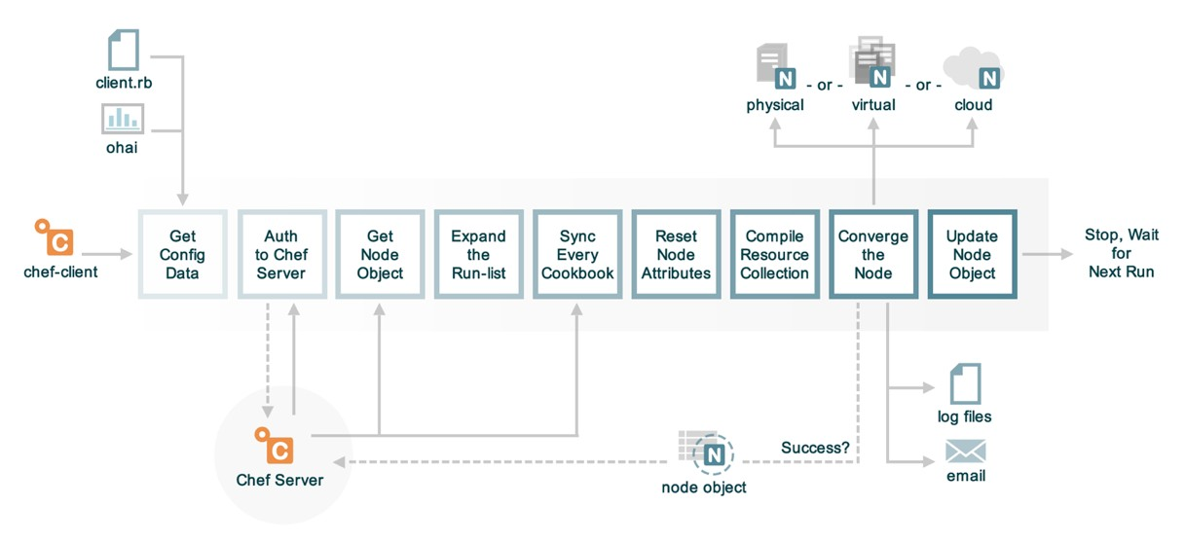
The Anatomy of a chef-client Run
Notes:
chef-client automatically loads the Ohai libraries and executes them to capture details about the system. These details are stored in the node object which is available in the recipes that we define. At the end of a successful chef-client run this node object is sent to the Chef Server.

Slide 29
Running Ohai in Code
> chef exec pry
[1] pry(main)> require 'ohai'
=> true
[2] pry(main)> ohai = Ohai::System.new
=> #<Ohai::System:0x007fc62fadc490 @plugin_pat...@safe_run=true>>
[3] pry(main)> ohai.all_plugins('ipaddress')
[4] pry(main)> ohai.all_plugins('hostname')
[5] pry(main)> ohai.all_plugins('memory')
[6] pry(main)> ohai.all_plugins('cpu')
[7] pry(main)> ohai.all_plugins
[8] pry(main)> exit
Notes:
chef-client run ohai in code as one of it's first steps. We can examine how that is done with Pry. Pry can be used as a debugger and as a REPL (Read-Evaluate-Print-Loop) tool. We can run this to allow to explore how Ohai is executed by the chef-client application.
First launch the session by running the specified command. Within this interactive session you can load the Ohai gem with the require command, create a new Ohai System object, and then ask the ohai object to load specific plugins or all plugins through the 'all_plugins' method. When you are done you can exit by entering the command 'exit'.

Slide 30
Exploring Ohai
To understand Ohai we must explore it in isolation, understand where it fits in the ecosystem, and how the data it provides is stored.
Execute Ohai to retrieve details about the node
View Ohai's execution within a chef-client run
Describe attributes precedence
Notes:
chef-client loads and executes Ohai within Ruby. Ohai returns Ruby object representations of the data that chef-client is able to evaluate and store within the node object. These attributes discovered by Ohai become attributes of the node object and it is important to take a quick moment to discuss how these attributes compare to the other attributes that may be defined in other locations within cookbooks, roles, and environments.

Slide 31
Node Attributes
A node object maintains the attributes collected from Ohai, from the previous node object (as returned by the Chef Server), from the environments, roles, and the cookbooks defined in the run list.
Notes:
Later within the chef-client a node object is created with the attributes collected from Ohai, the values previously stored on the Chef Server, and then the attributes defined in the environments, roles and cookbooks described in the node's run list. The node prioritizes and gives precedence to the attributes collected by Ohai.

Slide 32
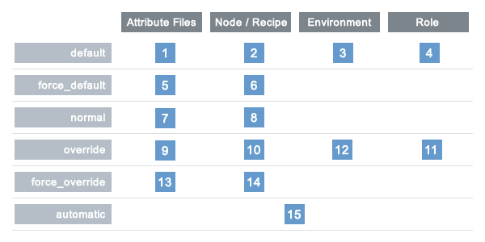
Viewing Attribute Precedence as a Table
LOCATION
LEVEL
Ohai
Notes:
This is a table representation of the various levels of precedence that can be specified with the location in which it can be specified. The lower the value, the lower the precedence. The higher the value, the higher the precedence.
The attributes collected from Ohai are considered automatic attributes granting them the value of 15. This means all data collected through Ohai attributes cannot ever be overridden.
That should make sense based on the data that we have queried so far in this module (e.g. CPU, memory). Never would we want to have an attribute defined in a cookbook or environment override this data collected about our system. This is also important when considering whether you want to create an Ohai plugin. The kind of data that you want to collect should not be data that you will want to override as it is data that describes the system and not data that you want to configure the system.

Slide 33
Exploring Ohai
To understand Ohai we must explore it in isolation, understand where it fits in the ecosystem, and how the data it provides is stored.
Execute Ohai to retrieve details about the node
View Ohai's execution within a chef-client run
Describe attributes precedence
Notes:
We have seen how to use Ohai as a command-line tool, explored how chef-client uses it, and seen the precedence level at which this data is stored. In the next module we will discuss Ohai's plugin history, its plugin structure, and the DSL (Domain Specific Language) it provides to express these plugins.

Slide 34
Agenda
Oh hai Ohai!
Meet and Greet with Ohai's Plugins
Build the Ohai plugin
Build a Recipe to deliver the plugin
Tuning Ohai
Questions
Resources
Hack Time!
CONCEPTS
TECHNICAL
TIPS
DISCUSSION

Slide 35
Reviewing the Ohai Gem
Ohai is a Rubygem. First we need to learn about how a gem is structured.
Review the basic structure of the Ohai gem
Review the 'language' plugin
Review the 'python' plugin
Notes:
To review the core plugins packaged with Ohai we need to spend some time reviewing the source code of the gem as none of the gems are not defined in documentation.

Slide 36
Ohai is Ruby Gem
Ruby gems are the ways in which Ruby developers share the code that they develop with others. A Ruby gem is really a packaging structure similar to that of a Chef cookbook.
Notes:
Ohai is a Ruby gem that is packed in the Chef Development Kit (Chef DK). A Ruby gem is a packaging structure that allows for the code to be reused and shared.

Slide 37

Searching for a Gem on Rubygems
Steps
Visit https://rubygems.org
Within the search field enter: ohai
Press enter or click the magnified glass at the right-side of the search box.
Click the 'Source Code' link
Click on 'Clone or download' and then copy the git URL.
Notes:
All Rubygems are stored on rubygems.org. We can come to the site and search for any gem by their name. Search for the Rubygem named "ohai".

Slide 38
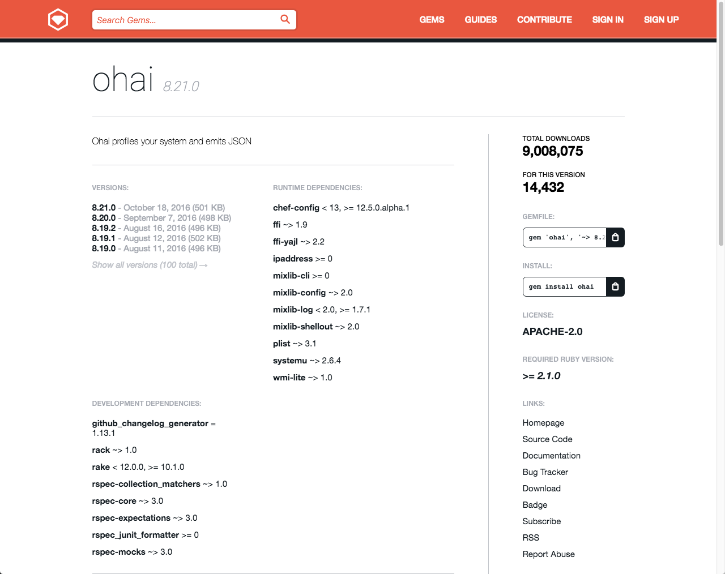
Searching for a Gem on Rubygems
Steps
Visit https://rubygems.org
Within the search field enter: ohai
Press enter or click the magnified glass at the right-side of the search box.
Click the 'Source Code' link
Click on 'Clone or download' and then copy the git URL.
Notes:
The project page for the gem itself contains important information about the releases, where to find the source, where to file issues, etc. We are interested in viewing the source of the project so we want to click on that link.

Slide 39
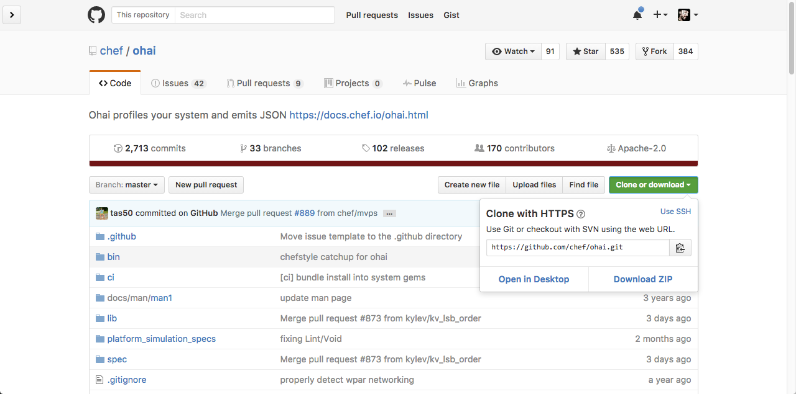
Searching for a Gem on Rubygems
Steps
Visit https://rubygems.org
Within the search field enter: ohai
Press enter or click the magnified glass at the right-side of the search box.
Click the 'Source Code' link
Click on 'Clone or download' and then copy the git URL.
Notes:
The ohai project is stored as a git repository within the Chef organization on GitHub. We can clone this project to our workstation to give us the ability to review the source code.

Slide 40
Returning to the Home Directory
> cd ~
Notes:
We are going to obtain the Ohai library on our local workstation so let's start by returning to the home directory.

Slide 41
Cloning the Ohai Library
> git clone https://github.com/chef/ohai.git
Cloning into 'ohai'...
remote: Counting objects: 20571, done.
remote: Compressing objects: 100% (31/31), done.
remote: Total 20571 (delta 7), reused 0 (delta 0), pack-reused 20540
Receiving objects: 100% (20571/20571), 4.46 MiB | 2.13 MiB/s, done.
Resolving deltas: 100% (13408/13408), done.
Checking connectivity... done.
Notes:
Git is installed with the Chef DK so we will use it to clone the Ohai project.

Slide 42
Viewing the Contents of the Project
> tree ohai
ohai
├── CHANGELOG.md
├── DOC_CHANGES.md
├── Gemfile
├── LICENSE
├── NOTICE
├── OHAI_MVPS.md
├── README.md
├── RELEASE_NOTES.md
├── Rakefile
├── appveyor.yml
├── bin
Notes:
The gem contains several important items within the top-level directory. We are going to explore the contents of some of the essential files.

Slide 43
Viewing the README
~/ohai/README.md
# ohai
... PROJECT BADGES ...
## Description
Ohai detects data about your operating system. It can be used standalone, but its primary purpose is to provide node data to Chef.
Ohai will print out a JSON data blob for all the known data about your system. When used with Chef, that data is reported back via node attributes.
Chef distributes ohai as a RubyGem. This README is for developers who want to modify the Ohai source code. For users who want to write plugins for Ohai, see the docs:
- General documentation: <https://docs.chef.io/ohai.html>
- Custom plugin documentation: <https://docs.chef.io/ohai_custom.html>
Notes:
The README contains information on how to install, configure and use this gem. This is often the place to start when exploring the gem.

Slide 44
Viewing the Gem Specification
~/ohai/ohai.gemspec
$:.unshift File.expand_path("../lib", __FILE__)
require "ohai/version"
Gem::Specification.new do |s|
s.name = "ohai"
s.version = Ohai::VERSION
s.platform = Gem::Platform::RUBY
s.summary = "Ohai profiles your system and emits JSON"
s.description = s.summary
s.license = "Apache-2.0"
s.author = "Adam Jacob"
s.email = "adam@chef.io"
s.homepage = "https://docs.chef.io/ohai.html"
s.required_ruby_version = ">= 2.1.0"
s.add_dependency "systemu", "~> 2.6.4"
Notes:
The gem specification defines important information about the Rubygem. Within it you will find metadata that describes the owner, licensing, contact information, dependencies, development dependencies, the files to package in the gem, and which one of those are executables.

Slide 45
Viewing the lib Directory
> tree ohai/lib
ohai/lib
├── ohai
│ ├── application.rb
│ ├── common
│ │ └── dmi.rb
│ ├── config.rb
...
│ └── version.rb
└── ohai.rb
19 directories, 161 files
Notes:
The lib (or library) directory contains the source code for this gem. Within the root of the directory you will find a single file that shares the same name as the gem.
In the previous module when we typed "require 'ohai'" this was the file that was loaded into memory.

Slide 46
Viewing the ohai.rb file in the lib Directory
~/ohai/lib/ohai.rb
#
# http://www.apache.org/licenses/LICENSE-2.0
#
# Unless required by applicable law or agreed to in writing, software
# distributed under the License is distributed on an "AS IS" BASIS,
# WITHOUT WARRANTIES OR CONDITIONS OF ANY KIND, either express or implied.
# See the License for the specific language governing permissions and
# limitations under the License.
#
require "ohai/version"
require "ohai/config"
require "ohai/system"
require "ohai/exception"
Notes:
This file requires more files from within the gem. The paths specified are relative to the 'lib' directory so all of these examples are loading files from within the subdirectory of ohai.

Slide 47
Viewing the plugins directory
> tree ohai/lib/ohai/plugins
ohai/lib/ohai/plugins
├── aix
│ ├── cpu.rb
│ ├── filesystem.rb
│ ├── kernel.rb
│ ├── memory.rb
│ ├── network.rb
│ ├── os.rb
│ ├── platform.rb
│ ├── uptime.rb
│ └── virtualization.rb
├── azure.rb
├── bsd
│ ├── filesystem.rb
Notes:
Ohai stores its plugins in a specific subdirectory of this project.

Slide 48
Reviewing the Ohai Gem
Let's take a look at the structure of a plugin.
Review the basic structure of the Ohai gem
Review the 'language' plugin
Review the 'python' plugin
Notes:
That was a quick introduction to the gem structure to give us an idea about where the plugins are stored. Now it is time to explore the Domain Specific Language (DSL) used to write these plugins.

Slide 49
Recent Major Ohai Releases
Ohai 6
Ohai 7
Ohai 8
Released: April 13, 2011
Chef Version: 0.10.0
docs.chef.io/release/ohai-6
Released: April 8, 2014
Chef Version: 11.12.0
docs.chef.io/release/ohai-7
Released: Dec. 4, 2014
Chef Version: 11.18.0
docs.chef.io/release/ohai-8
Notes:
Ohai has seen many notable releases. Depending on the version of Chef you are using within your organization may dictate which version of Ohai is being used.

Slide 50
Focus on Ohai 7
Ohai 7 refined the Domain Specific Language (DSL) created in the previous version of Ohai. Ohai 8 continues to use the same language.
Ohai 6
Ohai 7
Ohai 8
Notes:
Ohai 6 introduced the ability to express plugins through a DSL. Ohai 7 refined that DSL. Ohai 8 continues to use that same language. The following slides and our exercise in the next module will focus on the DSL defined in Ohai 7.

Slide 51
Viewing the Languages Plugin
~/ohai/lib/ohai/plugins/languages.rb
Ohai.plugin(:Languages) do
provides "languages"
collect_data do
languages Mash.new
end
end
Notes:
Let's load the languages plugin and review the basic structure of the plugin.

Slide 52
Viewing the Languages Plugin
~/ohai/lib/ohai/plugins/languages.rb
Ohai.plugin(:Languages) do
provides "languages"
collect_data do
languages Mash.new
end
end
Plugin Name
Ruby Symbol
First Letter Capitalized
Node attributes provided by the plugin
Code executed on all platforms and stored in the provided attribute(s).
Notes:
A plugin starts with invoking a method on the Ohai class with a single parameter. That parameter provided is the symbol name of the plugin. All Ohai plugins must have a symbol name with the first letter capitalized.
The remainder of the plugin is defined within the block of the 'plugin' method. The 'provides' method specifies what attribute or attributes the plugin will be added to the node object. The 'collect_data' method defines a block which contains the code that is executed on all platforms. This block of code will often times set the values of the attributes the plugin provides.

Slide 53
Viewing the Language Plugin
~/ohai/lib/ohai/plugins/languages.rb
Ohai.plugin(:Languages) do
provides "languages"
collect_data do
languages Mash.new
end
end
The Languages plugin provides the node attribute 'languages' which is populated, on all platforms, with a Mash.
Notes:
This plugin is named Languages. It provides the languages attribute on the node. This languages attribute is populated with the contents of a new Mash.
But what is a Mash?

Slide 54
Hash
Using a String as a key
Using a Symbol as a key
[1] pry(main)> content = Hash.new
=> {}
[2] pry(main)> content['name'] = 'Chef'
=> "Chef"
[3] pry(main)> content['name']
=> "Chef"
[4] pry(main)> content[:name]
=> nil
[1] pry(main)> content = {}
=> {}
[2] pry(main)> content[:name] = 'Chef'
=> "Chef"
[3] pry(main)> content[:name]
=> "Chef"
[4] pry(main)> content['name']
=> nil
Notes:
To understand what a Mash is first let's talk about Ruby's Hash. Hashes allow you to store values with a key; often times these keys are Ruby Strings or Ruby Symbols. When you want to retrieve that value you need to provide the same key. So if say you stored data with a Symbol key it is only retrievable with a Symbol key. The same could be said for using a String key.

Slide 55
Mash
Using a String as a key
Using a Symbol as a key
[1] pry(main)> require 'chef'
=> true
[2] pry(main)> content = Mash.new
=> {}
[3] pry(main)> content['name'] = 'Chef'
=> "Chef"
[4] pry(main)> content['name']
=> "Chef"
[5] pry(main)> content[:name]
=> "Chef"
[1] pry(main)> require 'chef'
=> true
[2] pry(main)> content = Mash.new
=> {}
[3] pry(main)> content[:name] = 'Chef'
=> "Chef"
[4] pry(main)> content[:name]
=> "Chef"
[5] pry(main)> content['name']
=> "Chef"
Notes:
A Mash is similar to a Ruby Hash except that it is indifferent to whether you provide it a String key or Symbol key. Either of those types of keys will return value stored by the other. This more lenient data structure allows for these two keys to be used interchangeably. Allowing us to use whichever key style we prefer without being penalized if we were to guess the key style that differs from other plugins.

Slide 56
Reviewing the Ohai Gem
Now it is time to look at a more complex plugin.
Review the basic structure of the Ohai gem
Review the 'language' plugin
Review the 'python' plugin
Notes:
The language plugin is small plugin that setups up a data structure for other language plugins to add more information to it. Let's review a specific language plugin to see a more complex implementation.

Slide 57
Viewing the Python plugin
~/ohai/lib/ohai/plugins/python.rb
Ohai.plugin(:Python) do
provides "languages/python"
depends "languages"
collect_data do
begin
so = shell_out("python -c \"import sys; print (sys.version)\"")
# Sample output:
# 2.7.11 (default, Dec 26 2015, 17:47:53)
# [GCC 4.2.1 Compatible Apple LLVM 7.0.2 (clang-700.1.81)]
if so.exitstatus == 0
python = Mash.new
output = so.stdout.split
python[:version] = output[0]
if output.length >= 6
Node attributes provided by the plugin
This plugin depends on the attributes in the Languages plugin to be defined
Notes:
Here within the Python plugin we see the same structure with a dependency and a significant amount of work being done in the 'collect_data' method block. The attribute provided by this plugin can be found on the node object under the specified path. Remember this is the same path structure you use on the command-line when wanting to traverse the attributes provided.
The dependency described here states that this plugin requires that the node attribute value 'languages' must be defined first before this plugin will execute. Ohai will determine how to execute the plugins based on these dependencies.

Slide 58
Viewing the Python plugin
~/ohai/lib/ohai/plugins/python.rb
Ohai.plugin(:Python) do
provides "languages/python"
depends "languages"
collect_data do
begin
so = shell_out("python -c \"import sys; print (sys.version)\"")
# Sample output:
# 2.7.11 (default, Dec 26 2015, 17:47:53)
# [GCC 4.2.1 Compatible Apple LLVM 7.0.2 (clang-700.1.81)]
if so.exitstatus == 0
python = Mash.new
output = so.stdout.split
python[:version] = output[0]
if output.length >= 6
Notes:
Within the collect_data block we use a helper method named 'shell_out'. This 'shell_out' method accepts a single parameter which is the command to run. This 'shell_out' method will generate an object for which you can ask for the standard output, standard error, and the exit status.
This command is executed and if the status is successful (0 status code) then look at the standard output, split it into multiple lines, extract the version and possibly any build date information, and then store that information into the Mash that was created by the Languages plugin. If a failure occurs at any point catch that error and display a debug message.
You will find that most Ohai plugins will fit the following pattern. Perform a system related call to collect some data, use Ruby to process that data, and then store the data.

Slide 59
collect_data for a specific Platform
Plugins can collect data in different ways across different platforms. When defining a collect_data block if you do not provide any arguments it is assumed the default and all platforms unless you define a collect_data block specific for a platform.

Slide 60
Reviewing the Ohai Gem
We know where the plugins are located and what they look like. Now it's time to make one.
Review the basic structure of the Ohai gem
Review the 'language' plugin
Review the 'python' plugin
Notes:
We were able to view the contents of the gem and examine the contents of a few plugins to give us an understanding of how plugins are structured. Now it is time for use to create our own.

Slide 61
Agenda
Oh hai Ohai!
Meet and Greet with Ohai's Plugins
Build the Ohai plugin
Build a Recipe to deliver the plugin
Tuning Ohai
Questions
Resources
Hack Time!
CONCEPTS
TECHNICAL
TIPS
DISCUSSION

Slide 62
Creating an Ohai Plugin
Being able to learn more about our nodes will make our reporting more powerful and benefit the recipes we write.
Define expectations for the Ohai plugin
Create the Ohai plugin

Slide 63
Installing the chefspec-ohai gem
> chef gem install chefspec-ohai
Successfully installed chefspec-ohai-0.1.0
1 gem installed

Slide 64
Adding the Gem to the Spec Helper
~/cookbooks/httpd/spec/spec_helper.rb
require 'chefspec'
require 'chefspec/berkshelf'
require 'chefspec/ohai'

Slide 65
Creating a Directory for Plugins Tests
> mkdir cookbooks/httpd/spec/unit/plugins

Slide 66
Defining the First Expectation for Plugin
~/cookbooks/httpd/spec/unit/plugins/httpd_modules_spec.rb
require 'spec_helper'
describe_ohai_plugin :Apache do
let(:plugin_file) { 'files/default/httpd_modules.rb' }
it 'provides apache/modules' do
expect(plugin).to provides_attribute('apache/modules')
end
end

Slide 67
Executing the Tests to See Failure
> chef exec rspec
F..........
Failures:
1) Apache provides 'apache/modules'
Failure/Error: let(:plugin_source) { File.read(plugin_file) }
Errno::ENOENT:
No such file or directory @ rb_sysopen - files/default/httpd_modules.rb

Slide 68
Creating an Ohai Plugin
Being able to learn more about our nodes will make our reporting more powerful and benefit the recipes we write.
Define expectations for the Ohai plugin
Create the Ohai plugin

Slide 69
Creating the Plugin as a Cookbook File
> chef generate file httpd_modules.rb
Recipe: code_generator::cookbook_file
* directory[/Users/franklinwebber/training/source/extending_cookbooks-repo/cookbooks/httpd/files/default] action create (up to date)
* template[/Users/franklinwebber/training/source/extending_cookbooks-repo/cookbooks/httpd/files/default/httpd_modules.rb] action create
- create new file /Users/franklinwebber/training/source/extending_cookbooks-repo/cookbooks/httpd/files/default/httpd_modules.rb
- update content in file /Users/franklinwebber/training/source/extending_cookbooks-repo/cookbooks/httpd/files/default/

Slide 70
Defining the Plugin that Provides Values
~/cookbooks/httpd/files/default/httpd_modules.rb
Ohai.plugin :Apache do
provides 'apache/modules'
end

Slide 71
Executing the Tests to See Success
> chef exec rspec
..........
Finished in 5.85 seconds (files took 2.74 seconds to load)
10 examples, 0 failures

Slide 72
Defining an Expectation for Attribute Value
~/cookbooks/httpd/spec/unit/plugins/httpd_modules_spec.rb
require 'spec_helper'
describe_ohai_plugin :Apache do
let(:plugin_file) { 'files/default/httpd_modules.rb' }
it 'provides apache/modules' do
expect(plugin).to provides_attribute('apache/modules')
end
it 'correctly captures output' do
allow(plugin).to receive(:shell_out).with('apachectl -t -D DUMP_MODULES').and_return(double(stdout: 'OUTPUT'))
expect(plugin_attribute('apache/modules')).to eq('OUTPUT')
end
end

Slide 73
Shelling Out to the Operating System!
plugin
Mixlib::ShellOut
OS
OS
OS
shell_out
cmd
shell_out

Slide 74
Stubbing Out the shell_out!
Mixlib::ShellOut
OS
OS
OS
plugin
RSpec Proxy
shell_out
?

Slide 75
Doubles
?
command
Optionally give me a name
code: double("command")
output: failed with a name

Slide 76
Doubles with a Name
?
Define methods using an unadorned hash of parameters. Key, values is the method name and the result of the method. You can even respond back with other variables or a block of code. But the goal of doubles is not to be fancy or have to worry about dependencies. The goal of doubles is to build the perfect replacement for that very moment. It has to do nothing else but act in a particular way for a particular moment and then dissapear. This lets you more easily create the various scenarios necessary to simulate all these various states.
code: double("command", name: 'jamie', title: 'Marvelous Human',)
code: show obj.name obj.title

Slide 77
Executing the Tests to See Failure
> chef exec rspec
.F.........
Failures:
1) Apache correctly captures output
Failure/Error: expect(plugin_attribute('apache/modules')).to eq("OUTPUT")
NoMethodError:
undefined method `[]' for nil:NilClass

Slide 78
Capturing the Apache Modules Content
~/cookbooks/httpd/files/default/httpd_modules.rb
Ohai.plugin :Apache do
provides 'apache/modules'
collect_data :default do
apache(Mash.new)
modules_cmd = shell_out('apachectl -t -D DUMP_MODULES')
apache[:modules] = modules_cmd.stdout
end
end

Slide 79
Executing the Tests to See Success
> chef exec rspec
.[2016-10-05T17:00:43-05:00] WARN: Plugin Definition Error: <files/default>: collect_data already defined on platform default
..........
Finished in 5.84 seconds (files took 3.01 seconds to load)
11 examples, 0 failures

Slide 80
Creating an Ohai Plugin
Being able to learn more about our nodes will make our reporting more powerful and benefit the recipes we write.
Define expectations for the Ohai plugin
Create the Ohai plugin

Slide 81
Agenda
Oh hai Ohai!
Meet and Greet with Ohai's Plugins
Build the Ohai plugin
Build a Recipe to deliver the plugin
Tuning Ohai
Questions
Resources
Hack Time!
CONCEPTS
TECHNICAL
TIPS
DISCUSSION

Slide 82
Plugin is Here in the Cookbook
1. Deliver plugin to a particular directory on our nodes
2. Inform ohai to load the plugin

Slide 83
ohai_plugin resource
The ohai community cookbook contains a custom resource that will deliver the plugin from the cookbook to a default directory on the node (/etc/chef/ohai_plugins or c:\chef\ohai_plugins) and it will also tell ohai to reload ohai to evaluate the plugin.

Slide 84
Creating an Ohai Plugin
Being able to learn more about our nodes will make our reporting more powerful and benefit the recipes we write.
Define expectations for the recipe to deliver the Ohai plugin
Create the recipe that delivers the Ohai plugin
Define an integration test

Slide 85
Adding a Dependency on the Ohai Cookbook
~/cookbooks/httpd/metadata.rb
name 'httpd'
maintainer 'The Authors'
maintainer_email 'you@example.com'
license 'all_rights'
description 'Installs/Configures httpd'
long_description 'Installs/Configures httpd'
version '0.1.0'
# If you upload to Supermarket you should set this so your cookbook
# gets a `View Issues` link
# issues_url 'https://github.com/<insert_org_here>/httpd/issues' if respond_to?(:issues_url)
# If you upload to Supermarket you should set this so your cookbook
# gets a `View Source` link
# source_url 'https://github.com/<insert_org_here>/httpd' if respond_to?(:source_url)
depends 'ohai'

Slide 86
Creating the Recipe to Add the Plugin
> chef generate recipe ohai_httpd_modules
Recipe: code_generator::recipe
* directory[/Users/franklinwebber/training/source/extending_cookbooks-repo/cookbooks/httpd/spec/unit/recipes] action create (up to date)
* cookbook_file[/Users/franklinwebber/training/source/extending_cookbooks-repo/cookbooks/httpd/spec/spec_helper.rb] action create_if_missing (up to date)
* template[/Users/franklinwebber/training/source/extending_cookbooks-repo/cookbooks/httpd/spec/unit/recipes/ohai_httpd_modules_spec.rb] action create_if_missing
...

Slide 87
Defining the Expectation Plugin Deployed
~/cookbooks/httpd/spec/unit/recipes/ohai_httpd_modules_spec.rb
# ... UPPER PORTION OF THE SPECIFICATION ...
let(:chef_run) do
runner = ChefSpec::ServerRunner.new
runner.converge(described_recipe)
end
it 'converges successfully' do
expect { chef_run }.to_not raise_error
end
it 'installs the modules plugin' do
expect(chef_run).to create_ohai_plugin('httpd_modules')
end
end
end

Slide 88
Execute the Tests to See Failure
> chef exec rspec
..........F
Failures:
1) httpd::ohai_httpd_modules When all attributes are default, on an unspecified platform installs the modules plugin
Failure/Error: expect(chef_run).to create_ohai_plugin('httpd_modules')
expected "ohai_plugin[httpd_modules]" with action :create to be in Chef run. Other ohai_plugin resources:

Slide 89
Creating an Ohai Plugin
Being able to learn more about our nodes will make our reporting more powerful and benefit the recipes we write.
Define expectations for the recipe to deliver the Ohai plugin
Create the recipe that delivers the Ohai plugin
Define an integration test

Slide 90
Defining the Ohai Plugin in the Recipe
~/cookbooks/httpd/recipes/ohai_httpd_modules.rb
#
# Cookbook Name:: httpd
# Recipe:: ohai_httpd_modules
#
# Copyright (c) 2016 The Authors, All Rights Reserved.
include_recipe 'httpd::default'
ohai_plugin 'httpd_modules'

Slide 91
Executing the Tests to See Success
> chef exec rspec
...........
Finished in 5.77 seconds (files took 2.62 seconds to load)
12 examples, 0 failures

Slide 92
Creating an Ohai Plugin
Being able to learn more about our nodes will make our reporting more powerful and benefit the recipes we write.
Define expectations for the recipe to deliver the Ohai plugin
Create the recipe that delivers the Ohai plugin
Define an integration test

Slide 93
Appending the New Recipe to the Suite
~/httpd/.kitchen.yml
# ... TOP OF KITCHEN CONFIGURATION ...
suites:
- name: default
run_list:
- recipe[httpd::default]
- recipe[httpd::ohai_httpd_modules]
verifier:
inspec_tests:
- test/recipes
attributes:

Slide 94
Converging the Updated Default Suite
> kitchen converge
-----> Starting Kitchen (v1.11.1)
-----> Converging <default-centos-67>...
resolving cookbooks for run list: ["httpd::default", "httpd::ohai_httpd_modules"]
Synchronizing Cookbooks:
- ohai (4.2.2)
- httpd (0.1.0)
- compat_resource (12.14.7)
Installing Cookbook Gems:
Compiling Cookbooks...
Recipe: httpd::ohai_httpd_modules

Slide 95
Defining an Expectation for the Plugin
~/httpd/test/recipes/ohai_httpd_modules.rb
plugin_directory = '/tmp/kitchen/ohai/plugins'
describe command("ohai -d #{plugin_directory} apache") do
its(:stdout) { should match(/core_module/) }
end

Slide 96
Verifying the New Expectation
> kitchen verify
-----> Starting Kitchen (v1.11.1)
-----> Verifying <ohai-plugin-centos-67>...
Use `/home/chef/httpd/test/recipes/default` for testing
Target: ssh://kitchen@localhost:32768
✔ Command ohai -d /tmp/kitchen/ohai/plugins apache stdout should match /core_module \(static\)/
Summary: 1 successful, 0 failures, 0 skipped

Slide 97
Creating an Ohai Plugin
Being able to learn more about our nodes will make our reporting more powerful and benefit the recipes we write.
Define expectations for the recipe to deliver the Ohai plugin
Create the recipe that delivers the Ohai plugin
Define an integration test

Slide 98
Agenda
Oh hai Ohai!
Meet and Greet with Ohai's Plugins
Build the Ohai plugin
Build a Recipe to deliver the plugin
Tuning Ohai
Questions
Resources
Hack Time!
CONCEPTS
TECHNICAL
TIPS
DISCUSSION

Slide 99
Run Ohai Smoother
There are a few more things to learn about Ohai that could help increase performance.
Configure the node to automatically load ohai plugins
Enable ohai hints
Remove plugins that you do not want executed
Choose only the plugins you want executed

Slide 100
Node Configuration File
All nodes have a configuration file that contain details about node, overrides, and other data.

Slide 101
The Anatomy of a chef-client Run

Slide 102
chef-client cookbook
The chef-client cookbook contains a number of useful recipes:
service (default)
Run chef-client as a service, converging at a periodic interval
delete_validation
Remove the organization validation key [SECURITY ISSUE]
config
Define node configuration
https://supermarket.chef.io/cookbooks/chef-client

Slide 103
Viewing the chef-client config Recipe
~/cookbooks/chef-client/recipes/config.rb
# ... OTHER RESOURCES ...
template "#{node["chef_client"]["conf_dir"]}/client.rb" do
source 'client.rb.erb'
owner d_owner
group d_group
mode 00644
variables(
:chef_config => node['chef_client']['config'],
:chef_requires => chef_requires,
:ohai_disabled_plugins => node['ohai']['disabled_plugins'],
:start_handlers => node['chef_client']['config']['start_handlers'],
:report_handlers => node['chef_client']['config']['report_handlers'],
:exception_handlers => node['chef_client']['config']['exception_handlers']
)
notifies :create, 'ruby_block[reload_client_config]', :immediately
end

Slide 104
~/cookbooks/chef-client/templates/default/client.rb.erb
<% if node.attribute?("ohai") && node["ohai"].attribute?("plugin_path") -%>
Ohai::Config[:plugin_path] << "<%= node["ohai"]["plugin_path"] %>"
<% end -%>
<% unless @ohai_disabled_plugins.empty? -%>
Ohai::Config[:disabled_plugins] = [<%= @ohai_disabled_plugins.map { |k| k...
<% end -%>

Slide 105
The Work
Add the chef-client cookbook to your cookbook collection
Provide attributes in a wrapper cookbook, role, or environment for:
node['ohai']['plugin_path']
Add chef-client cookbook to every node's run list

Slide 106
Run Ohai Smoother
There are a few more things to learn about Ohai that could help increase performance.
Configure the node to automatically load ohai plugins
Enable ohai hints
Remove plugins that you do not want executed
Choose only the plugins you want executed

Slide 107
Not all Node Plugins are Executed
Some of the plugins will not automatically run against your node. This is particularly true of the cloud provider plugins. As the node does not often know the environment in which is being run.

Slide 108
Ohai Hints
For those plugins that are not executed you can leave them a hint file that will ensure they are executed.

Slide 109
The Work
Add the ohai cookbook to your cookbook collection
Define a recipe that uses the ohai cookbook's ohai_hint resource
Add this recipe to every node's run list

Slide 110
Run Ohai Smoother
There are a few more things to learn about Ohai that could help increase performance.
Configure the node to automatically load ohai plugins
Enable ohai hints
Remove plugins that you do not want executed
Choose only the plugins you want executed

Slide 111
~/cookbooks/chef-client/templates/default/client.rb.erb
<% if node.attribute?("ohai") && node["ohai"].attribute?("plugin_path") -%>
Ohai::Config[:plugin_path] << "<%= node["ohai"]["plugin_path"] %>"
<% end -%>
<% unless @ohai_disabled_plugins.empty? -%>
Ohai::Config[:disabled_plugins] = [<%= @ohai_disabled_plugins.map { |k| k...
<% end -%>

Slide 112
Viewing the chef-client config Recipe
~/cookbooks/chef-client/recipes/config.rb
# ... OTHER RESOURCES ...
template "#{node["chef_client"]["conf_dir"]}/client.rb" do
source 'client.rb.erb'
owner d_owner
group d_group
mode 00644
variables(
:chef_config => node['chef_client']['config'],
:chef_requires => chef_requires,
:ohai_disabled_plugins => node['ohai']['disabled_plugins'],
:start_handlers => node['chef_client']['config']['start_handlers'],
:report_handlers => node['chef_client']['config']['report_handlers'],
:exception_handlers => node['chef_client']['config']['exception_handlers']
)
notifies :create, 'ruby_block[reload_client_config]', :immediately
end

Slide 113
The Work
Add the chef-client cookbook to your cookbook collection
Select attributes you want to remove
Find the name of the plugin that provides those attributes
Provide attributes in a wrapper cookbook, role, or environment for:
node['ohai']['disabled_plugins']
Add chef-client cookbook to every node's run list

Slide 114
Run Ohai Smoother
There are a few more things to learn about Ohai that could help increase performance.
Configure the node to automatically load ohai plugins
Enable ohai hints
Remove plugins that you do not want executed
Choose only the plugins you want executed

Slide 115
Whitelist Node Attributes
When it seems like you are disabling far too many plugins and you want to consider attacking it from the other side:
http://ckbk.it/whitelist-node-attrs

Slide 116
Run Ohai Smoother
There are a few more things to learn about Ohai that could help increase performance.
Configure the node to automatically load ohai plugins
Enable ohai hints
Remove plugins that you do not want executed
Choose only the plugins you want executed

Slide 117
Agenda
Oh hai Ohai!
Meet and Greet with Ohai's Plugins
Build the Ohai plugin
Build a Recipe to deliver the plugin
Tuning Ohai
Questions
Resources
Hack Time!
CONCEPTS
TECHNICAL
TIPS
DISCUSSION

Slide 118
Let Us Have a Discussion
"Ask a Question" and I will answer it.
"Rate this" presentation to leave your feedback and help me do my work better.
To share, click on the appropriate professional/social network in "Details"
Notes:
We’d love to hear from you during today’s presentation. I’ll be answering questions at the end of the session, so please feel free to send those along using the ‘Ask a Question’ tab on the top of your screen.
If you want to leave a comment and tell me how I did and how we are doing here at Chef please leave a rating and tells us what you liked, what you didn't like, and what you would like to see more of during these sessions.
And last, I'd like to encourage you to share today’s webinar with your professional and social networks.

Slide 119
Q&A
What questions can I answer for you?

Slide 120
Agenda
Oh hai Ohai!
Meet and Greet with Ohai's Plugins
Build the Ohai plugin
Build a Recipe to deliver the plugin
Tuning Ohai
Questions
Resources
Hack Time!
CONCEPTS
TECHNICAL
TIPS
DISCUSSION

Slide 121
Resources for Ohai
What resources have helped you understand Ohai better?

Slide 122

Check The Attachments
All of the resources I am going to provide you can be found under "Attachments".

Slide 123
Presentation Resources
Slides
github.com/chef-training/webinars/raw/master/build_a_custom_ohai_plugin.pdf
Example Cookbook
github.com/chef-training/webinar-ohai-repo
chefspec-ohai gem
github.com/burtlo/chefspec-ohai
Learn Chef Tutorial
learn.chef.io/tutorials/build-an-ohai-plugin

Slide 124
Creating a Gem like chefspec-ohai
Learn more about the structure of the chefspec-ohai gem which defined a lot of those special test helpers.
Write more elegant tests!
chef.io/webinars/?commid=235083

Slide 125
Agenda
Oh hai Ohai!
Meet and Greet with Ohai's Plugins
Build the Ohai plugin
Build a Recipe to deliver the plugin
Tuning Ohai
Questions
Resources
Hack Time!
CONCEPTS
TECHNICAL
TIPS
DISCUSSION

Slide 126


